Slide 1
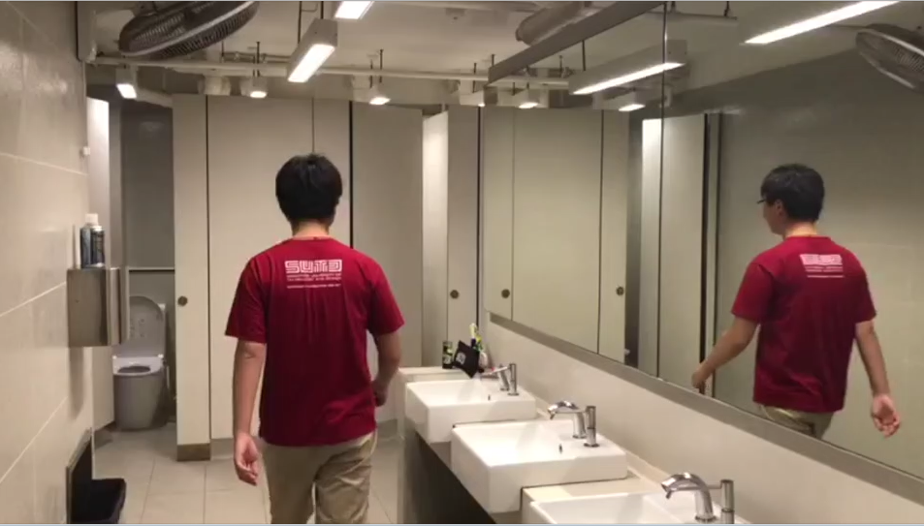
0-4
Actor walk towards to bathing cubical
BGM:

Slide 2
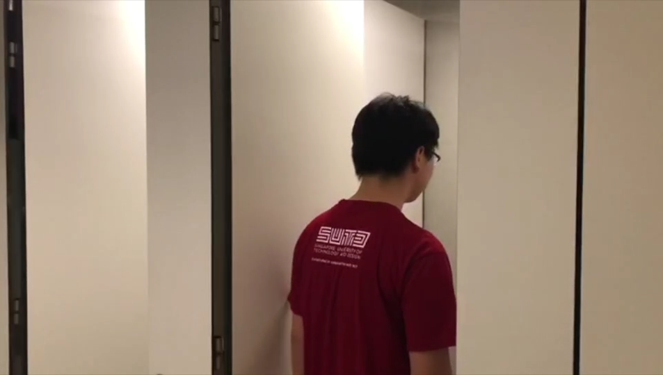
4-7
Actor enter the cubical

Slide 3
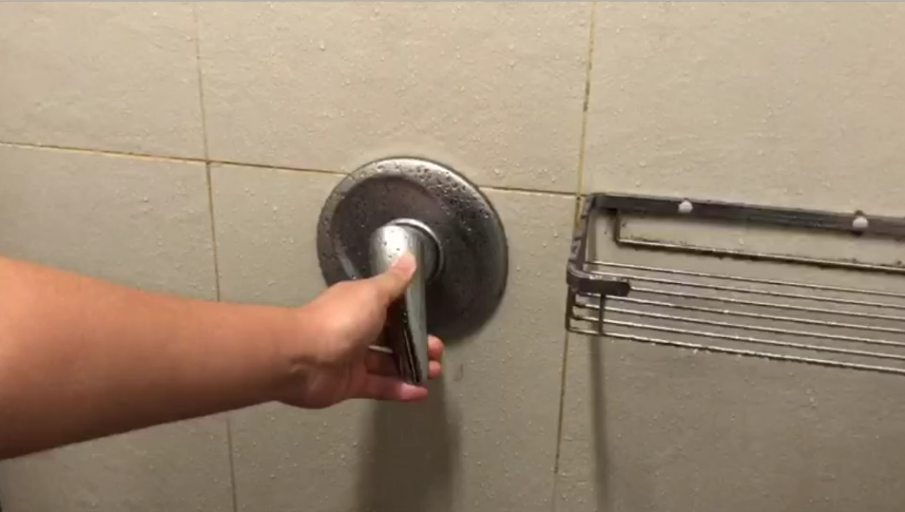
7-9
Turn on the shower head

Slide 4
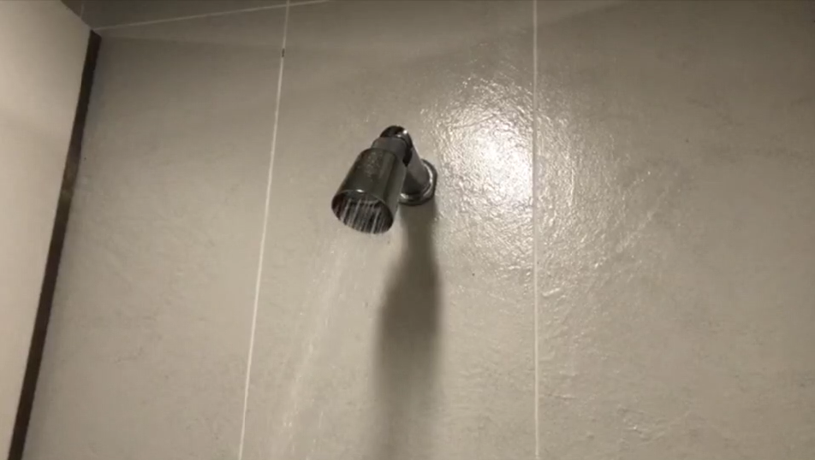
9-11
Shower head spray water

Slide 5
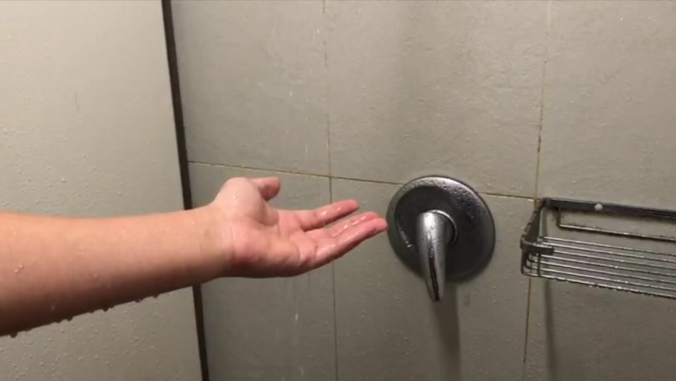
11-13
Touch the water

Slide 6

13-18
Too cold, shiver

Slide 7
11-13
Turning up the heat all the way

Slide 8
13-18
Stunned face, got burned

Slide 9
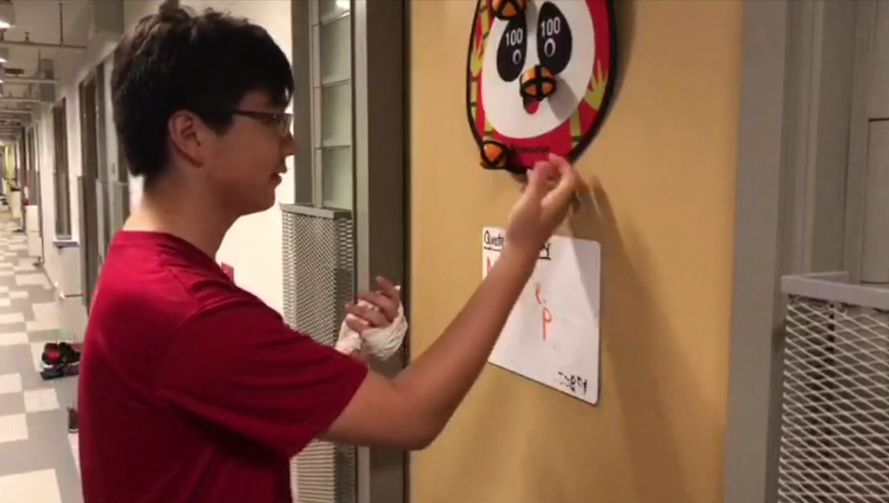
18-23
Knock on door, ask for help

Slide 10
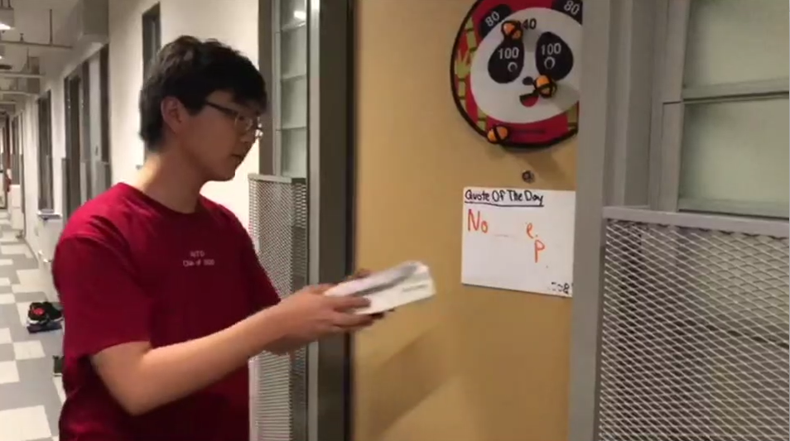

23-30
Receive the device, open the instruction
Enter introduction

Slide 11
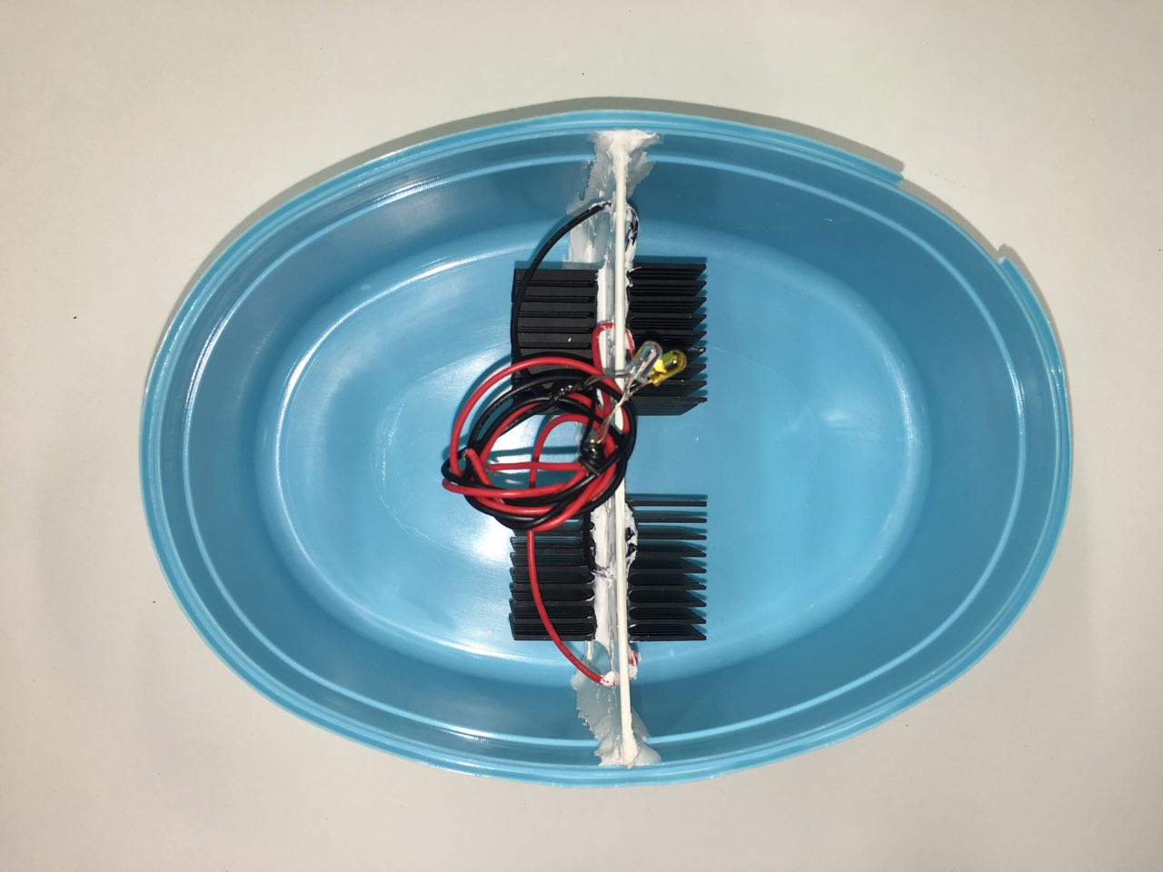
hot water
(mixed shower water)
cold water
(room temp. water)
Peltier chip

Slide 12
LED lights
current
measured
potential difference
measured
Peltier chip

Slide 13
30-60
LED lights
divider
current
measured
Introduce the various part and function of our device
water basin
hot water
(mixed shower water)
cold water
(room temp. water)
potential difference
measured
heat sinks
Peltier chip
Notes:
This is our prototype to illustrate the proof of concept.
By putting a Peltier chip (highlight) between the hot and cold water (highlight), it generates an e.m.f. and lights up the LED (highlight).
Heat sinks are placed to increase conductivity between the water and the Peltier chip

Slide 14

75-105
Explanation of concept
This is how our peltier chip powers the LED
The flow of heat from the hot side to the cold side brings along the charge carriers.
This flow of charge carriers power the external circuit.
The seeback voltage increases with increasing temperature difference.
SHOW P-N peltier chip Show temperature – V_se graph

Slide 15
10.1oC > T-diff
2.21V > V-se
SIDE VIEW
Notes:
(no light | one light | two lights)
If the water is too cold, no LED will light up. If the water is too hot, both LED is light up. If the water is of an acceptable temperature, only the amber LED lights up.

Slide 16
T-diff > 12.1oC, V-se > 2.44V
Notes:
(no light | one light | two lights)
If the water is too cold, no LED will light up. If the water is too hot, both LED is light up. If the water is of an acceptable temperature, only the amber LED lights up.
The amber LED lights up when potential difference is above 2V. However, the blue LED lights up with there is a potential difference of 3V.

Slide 17
10.1oC > T-diff > 12.1oC, 2.21V > V-se > 2.44V
Notes:
(no light | one light | two lights)
If the water is too cold, no LED will light up. If the water is too hot, both LED is light up. If the water is of an acceptable temperature, only the amber LED lights up.

Slide 18
4-7
Actor enter the cubical

Slide 19
7-9
Turn on the shower head, adjust slowly

Slide 20
X-x
LED lights up
Just show the LED only

Slide 21
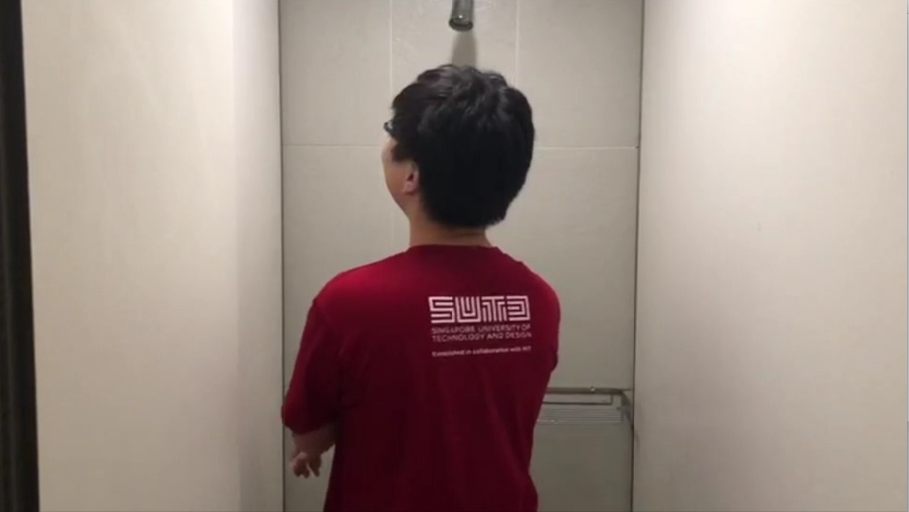
115-120
Shower without fear
Shower
Turn on the tape
Look at the led
Shower in peace

